Slide 1



Slide 2

THE ABOUT
PEOPLE
Vision
and Mission
People come first. We aim to offer supportive, collaborative work spaces where our people can grow in their role and in their community.
WORKPLACE
We are committed to providing a sustainable workplace that does not negatively impact our environment.
Our sustainability mission at Twist seeks to be a responsible, ethical business across all our operational activities. Our values are reflected in everything we do, from the everyday decisions we take to our long-term plans and goals.
Our strategy is focused on 4 key areas: covering the social and environmental topics which are most important to our customer; people and communities; and where Twist Health can have a real impact.
COMMUNITY
We want to be a positive name in our community – giving back to the communities we work with and within.
FUTURE FIRST
Everything we do is focused on having a positive impact on the future. From our procurement practices through to disposing of coffee grinds – every detail is important!

Slide 3
As a smaller business it is important to us that we set up ethical and sustainable business practices from day one. This means that our business will scale and grow around sustainable practices, without having to implement huge change policies in years to come!
We also recognise the limitations of being a smaller company, but we can still make an impact to our local communities and set forth our mission to do so.
This document sets out our vision, mission and our KPIs for working towards our sustainability goals.
THE ABOUT
Introduction to
Twist Sustainability

Slide 4
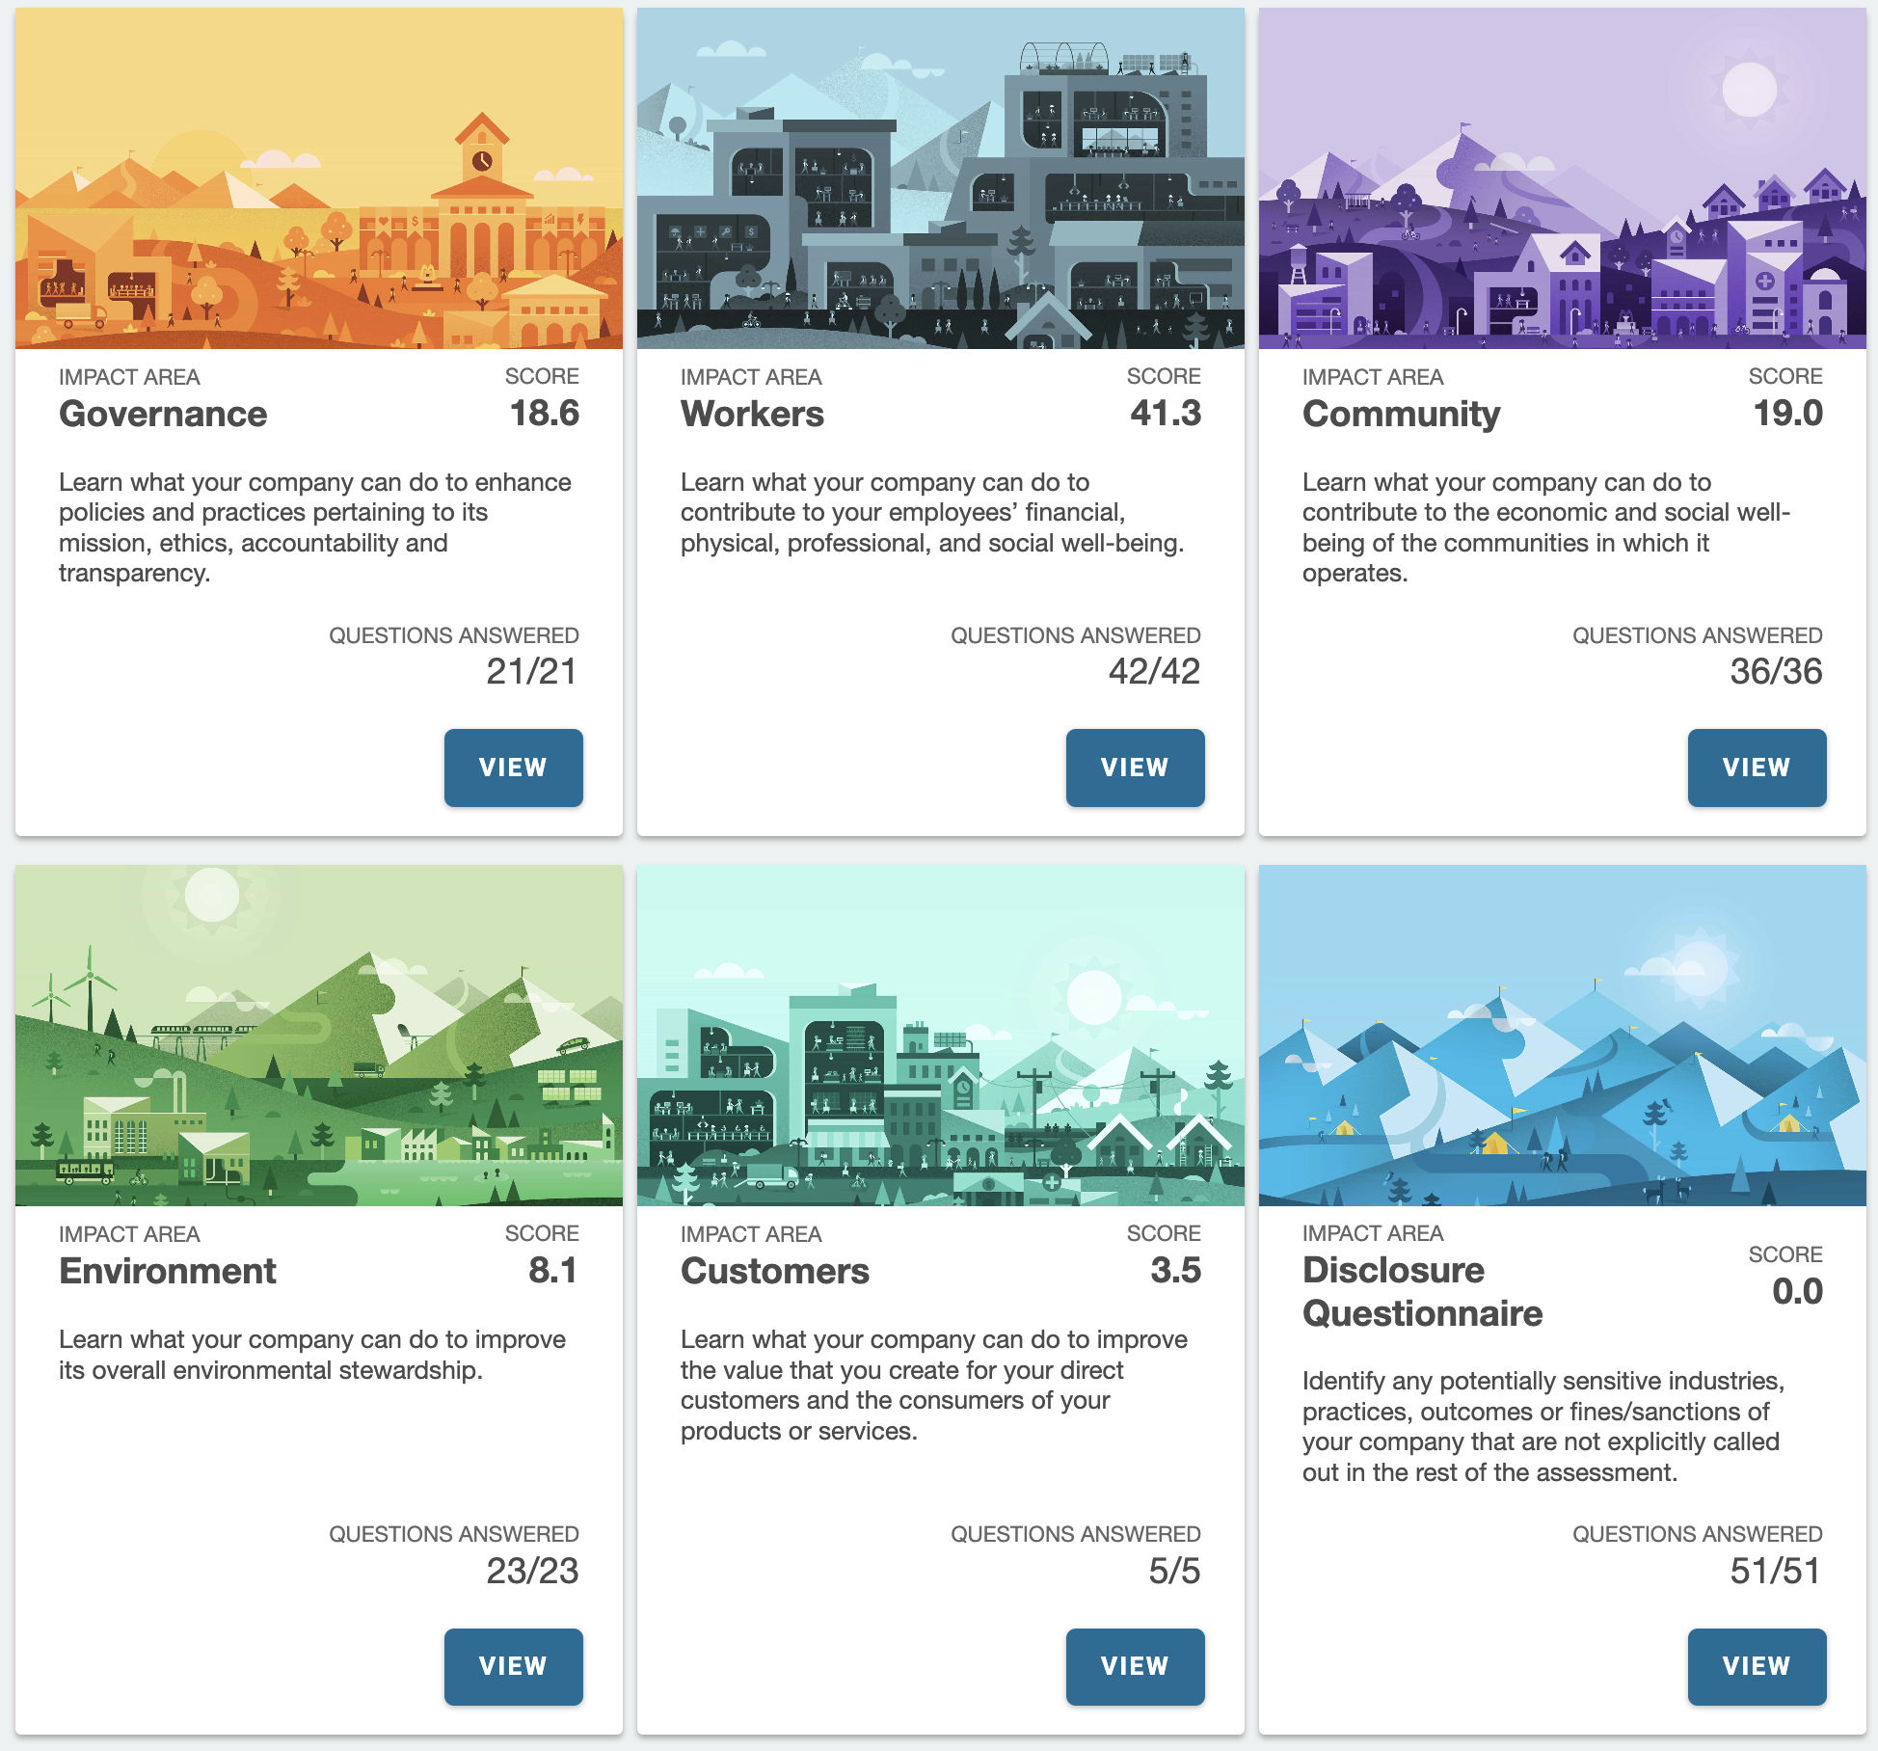
2023 B Corp scores: How we did

Slide 5
AND HOW
IS IT GOING?

Slide 6
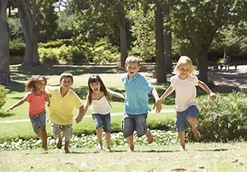

SUSTAINABLITY PROMISE
Future
First
PROCUREMENT
Ensure that our procurement practices have social and environmental consideration. Continue to evaluate suppliers based upon environmental impact.
Although small, we recognise the importance of ensuring sustainable practices are a part of our organisation from the beginning. We want to position the future of our business for positive success within our environment and be mindful of our operations.
OPERATIONS
Ensure reporting and measurement is more robust enabling Twist to measure their environmental impact in a more formal manner than current operations.
GROWTH STRATEGY
FUTURE FIRST
As part of our growth strategy, include a section that considers our social and environmental impact, assessment and action so sustainability is built into every aspect of our business plan.
Everything we do is focused on having a positive impact on for the future. From our procurement practices through to disposing of coffee grinds – every detail is important!

Slide 7
What we said we would do: | What we did: | What we are going to do:
Performance reviews continue to reflect the social and environmental impact of the business and adapt as necessary. | Continued to ensure that all performance reviews allocate at least 10-15 minutes to discuss how employees can contribute to the social and environmental goals of the business and any thoughts they have on overarching goals. | We will continue to do this.
Work with renewable energy sources and ensure we can track usage to identify areas of high use and mitigate as appropriate. | Using renewable energy for electricity and focussing on minimal waste-water. We have developed a tracker to track use month to month to assess where improvements can be made. We have also employed a business support assistant to keep an eye on escalating costs and look for ways to reduce waste. | We will continue to be mindful of energy waste and encourage all members of the team to do the same.
Offer employees environmental training to assess environmental impact. | Included social and environmental measurement and impact measures as part of our management and executive job descriptions to ensure team members understand the role they play in the company’s overall sustainability mission. | We will continue to remind employees of this.
Development of a supplier assessment and onboarding sheet whereby we can validate a supplier’s social and environmental impact. | We have a simplified assessment sheet whereby we can assess suppliers and their impact. | We will continue to update and check this.

Slide 8
What we said we would do: | What we did: | What we are going to do:
Include sustainability strategy and measures as part of the Twist Health growth plan. | This has been a key element of our 2024-25 business planning and strategy with a significant portion being focussed upon working with other BCorps and working sustainably with partners, as well as the growth of the company being responsible. | We will continue to do this.
Assess energy provider / solar panels | We have investigated the use of solar panels but have been informed that our roof is not suitable. | We are looking into other way that we can reduce energy.
Gain ISO9001 and ISO14001 certifications | Running through the ISO audits and successfully achieving the ISO certifications for quality and environmental impact | We will continue to do this.
Reassess energy providers to determine if there is a more sustainable provider available. | Completed audit of suppliers and costs of solar panels. | Sadly solar panels are not viable. We have a broker who finds the best energy provider for us and ensure they understand our values.
Ensure social and environmental performance is publicly available. | Create a webpage on our corporate page that publicly holds us accountable to our 2024 objectives and reports on achievements in 2023. | We will update this.

Slide 9
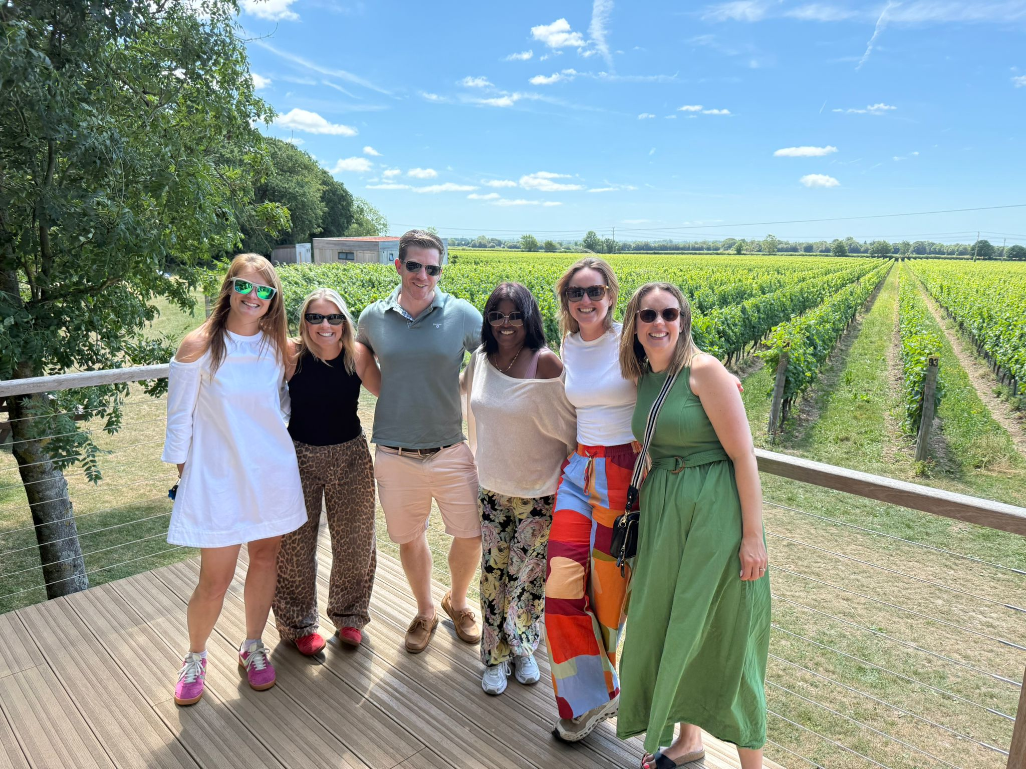
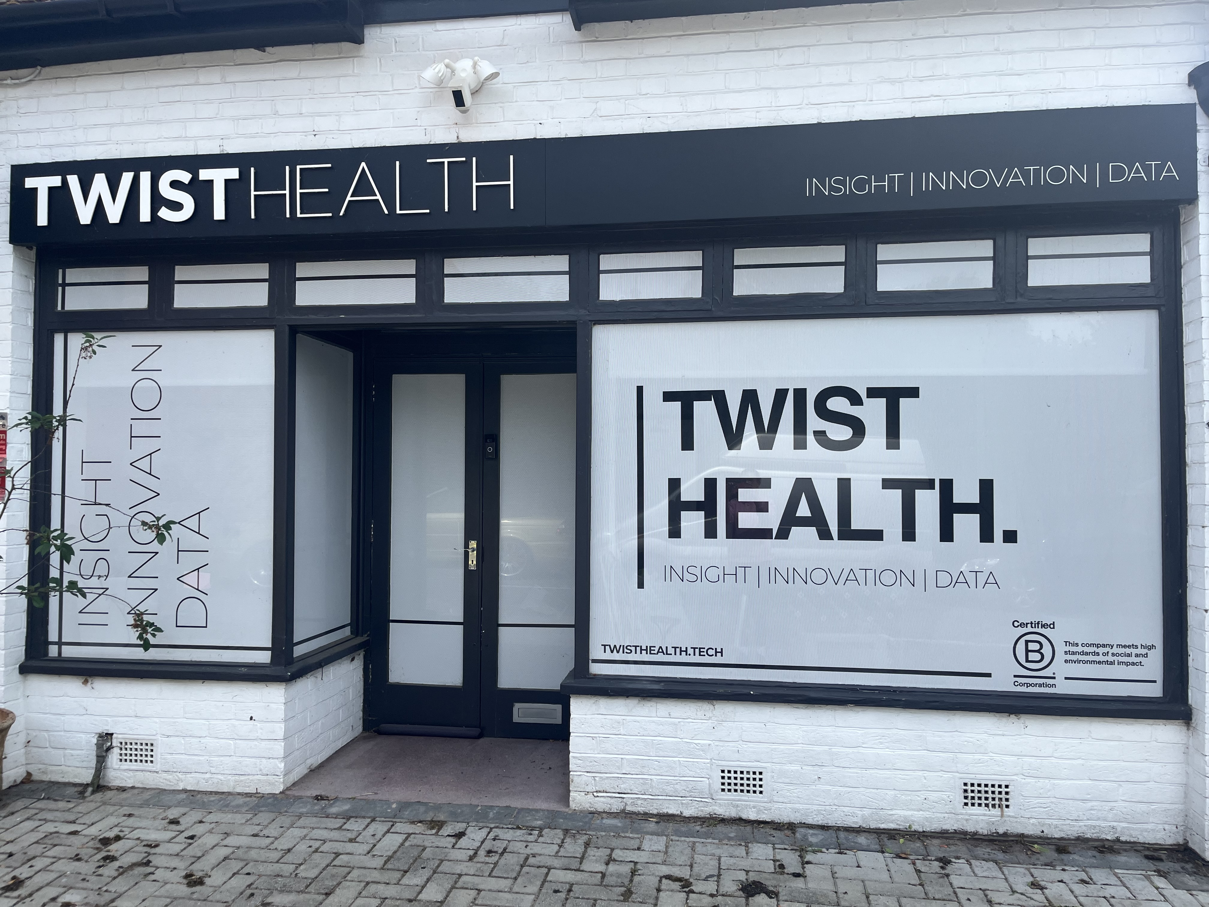
SUSTAINABLITY PROMISE
WORKPLACE
We have a central office in Twyford near Winchester, but our people are supported to work from the places that mean they get the most out of their day. Where you work should not be a barrier to advancement in your career.
Our
People
TRAINING
Our people are the most important part of our business and as a female owned corporation we understand the pressures of juggling work and life as well as giving back to the local communities.
We offer our employees training in all aspects of their career from regulatory training to environmental impact training as well as funding further training to support career development. But we aim to do more.
ENVIRONMENTAL AND SOCIAL IMPACT
Ensuring that all job descriptions across Twist have considered social and environmental impact as well as managers. Performance reviews reflect this consideration and action taken to support managers and staff where needed. We also endeavour to partner with smaller independent and local freelancers, where we will pay invoices immediately and not make our small suppliers wait, potentially putting their business at risk.
PEOPLE
People come first. We aim to offer supportive, collaborative work-spaces where our people can grow in their role and in their community.

Slide 10

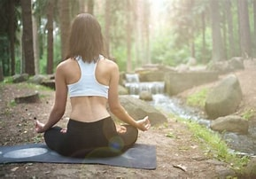
SUSTAINABLITY PROMISE
WELLNESS
Our
People
We want to ensure the health of our employees and as such our full-time (FT) employees have life and health insurance offered to them when working for Twist.
REIMBURSEMENT
Our people are the most important part of our business and as a female owned corporation we understand the pressures of juggling work and life as well as giving back to the local communities.
We strive to ensure that our employees are financially looked after, paying wages above that of living wage and ensuring bonus structures are aligned to overall performance, and not financial performance of the business.
BALANCE
Ensuring our employees work in a safe and supported environment that ensures the success of our employees and, not just the company, is paramount. FT Employees are given a minimum of 33 days holiday a year plus 3 days between Christmas and New Year. We also offer flexible working to all employees inclusive of place of work and hours/days.
PEOPLE
People come first. We aim to offer supportive, collaborative work-spaces where our people can grow in their role and in their community.

Slide 11
What we said we would do: | What we did: | What we are going to do:
Performance reviews continue to reflect the social and environmental impact of the business and adapt as necessary. | We continued to ensure that all performance reviews were allocated at least 10-15 minutes to discuss how employees can contribute to the social and environmental goals of the business and any thoughts they have on overarching goals. | We will continue to have performance reviews and find out how employees can contribute.
Actively seek opportunities for employees to volunteer within our new local community. | Two members of our team voluntarily organised the local Twyford 10k trail race. It was a huge success and we were able to donate £4,500 to the local primary school. | We intend to organise the trail race in 2027 with both members being fully involved. We intend to increase the number of runners and raise money for more charities, including the local school.
Provide at least 1 day a month for full time employees to work in the community and offer voluntary time to local causes. | This has continually been available to our employees. | We will continue to offer this.
Provide activity in the workplace that enables movement and enrichment, to include a run club at work. | We have encouraged flexible working hours to ensure employees can use their workday efficiently to include movement and wellbeing initiatives. Most members of our team run/jog on their lunch break. We have adjustable desks so team members can stand or sit. | We have a member of staff looking into a cycle route from home. We will continue to encourage our team to be active.
Continue to track payment terms with small freelancers and suppliers to ensure immediate invoice payment. | Over 95% of invoices to freelancers and small businesses were paid within 1 week of receipt in 2025. In addition to this, when we moved offices, we proactively sought out contractors to support with the renovation of the office that were local, and that the office would have a meaningful impact on: both personally and financially. This equated to over £10,000 being invested in local (living less than 2 miles) tradespeople (with another £5,000 upcoming in April) | We will continue to use local resources and support small freelancers and suppliers.

Slide 12
What we said we would do: | What we did: | What we are going to do:
We are also assessing the provision for employees that are remote to provide them with a workspace (shared office or similar) outside of the home to work from instead of working from their private residence. | We found that our team were happy to work from home and this was much more convenient for their lifestyles. They felt they were much more productive with their time and helped with family life. | We will continue to consider our team members’ needs and adapt working space accordingly if necessary.
Continue to build good relationships within our team. | We checked in regularly with our team members and invited them to the office for face to face meetings. | We will be holding a team building event in July.

Slide 13
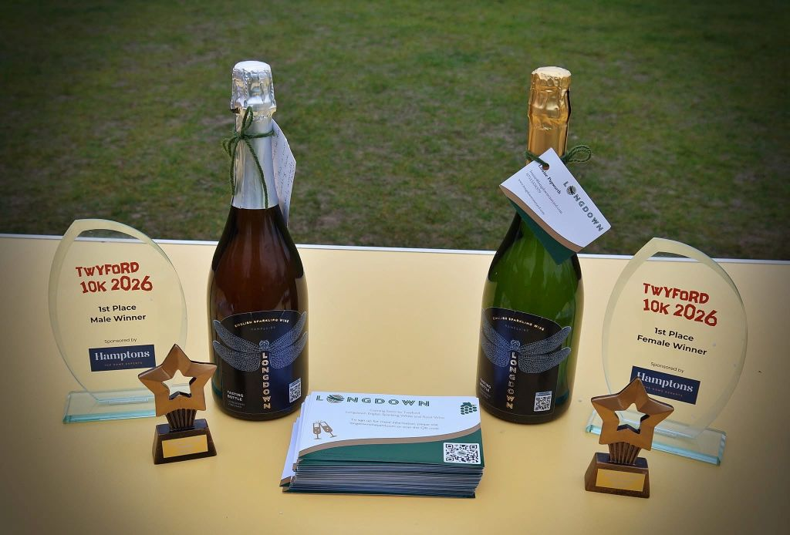
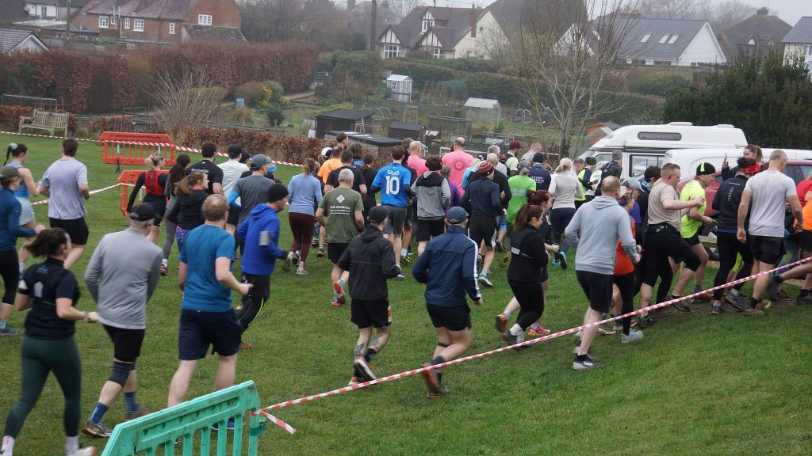
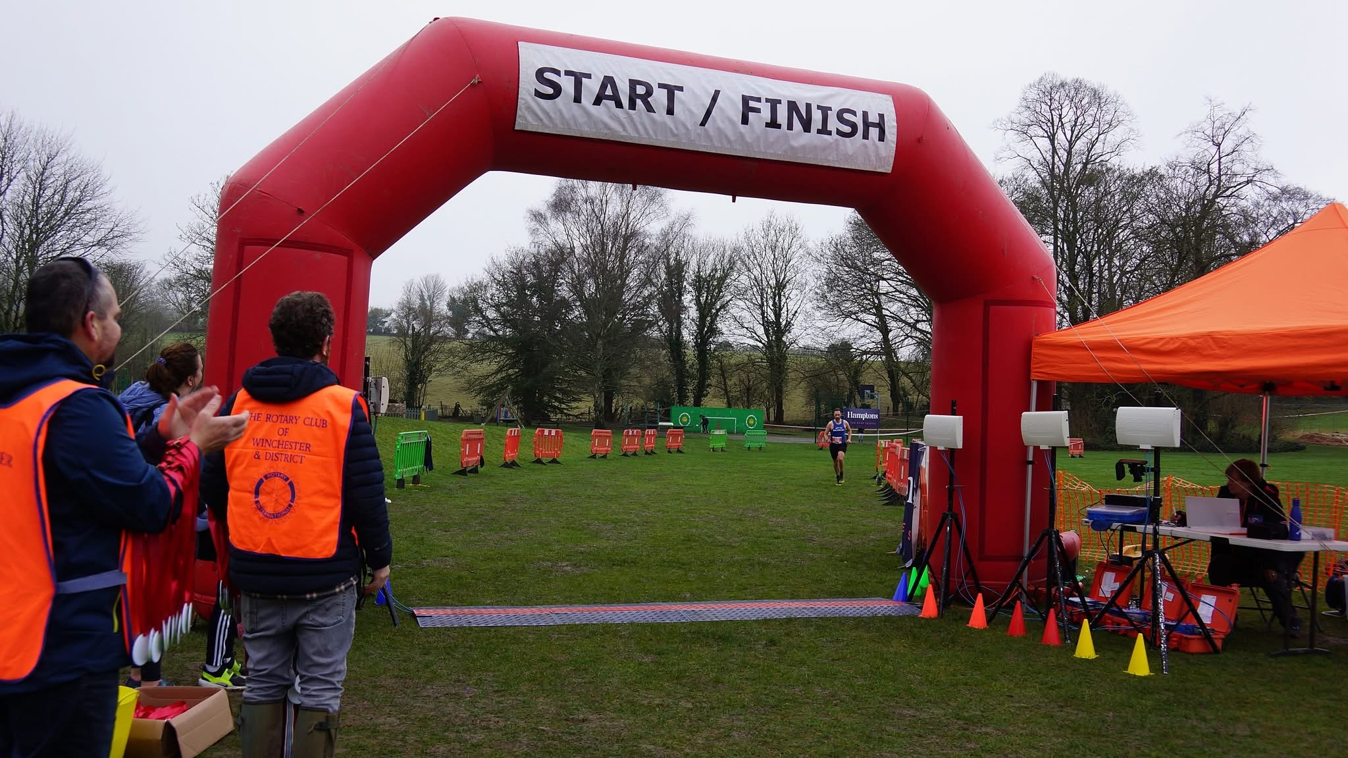
SUSTAINABLITY PROMISE
Our
Community
LOCAL SUPPLIERS
Where possible we use local suppliers for work and contribute to the local community, this not only reduces our carbon footprint but supports local businesses.
OPPORTUNITIES FOR YOUNG PEOPLE
Health is something that affects all of us so, as a service provider in the healthcare space, it is important that where we can we raise awareness and support healthy living within our local community.
We sponsor a local youth football team and provide volunteering opportunities to our employees, to ensure that healthy mindsets and the opportunities for sports in young people are provided and easily accessible within the community.
COMMUNITY
We want to be a positive name in our community – giving back to the communities we work with and within.
CHARITABLE CAUSES
We funded the Twyford 10k trail race and two members of our team voluntarily organised the race. It was a huge success and were able to donate £4,500 to the local primary school. We intend to organise the race again next year and donate to further charitable causes.

Slide 14
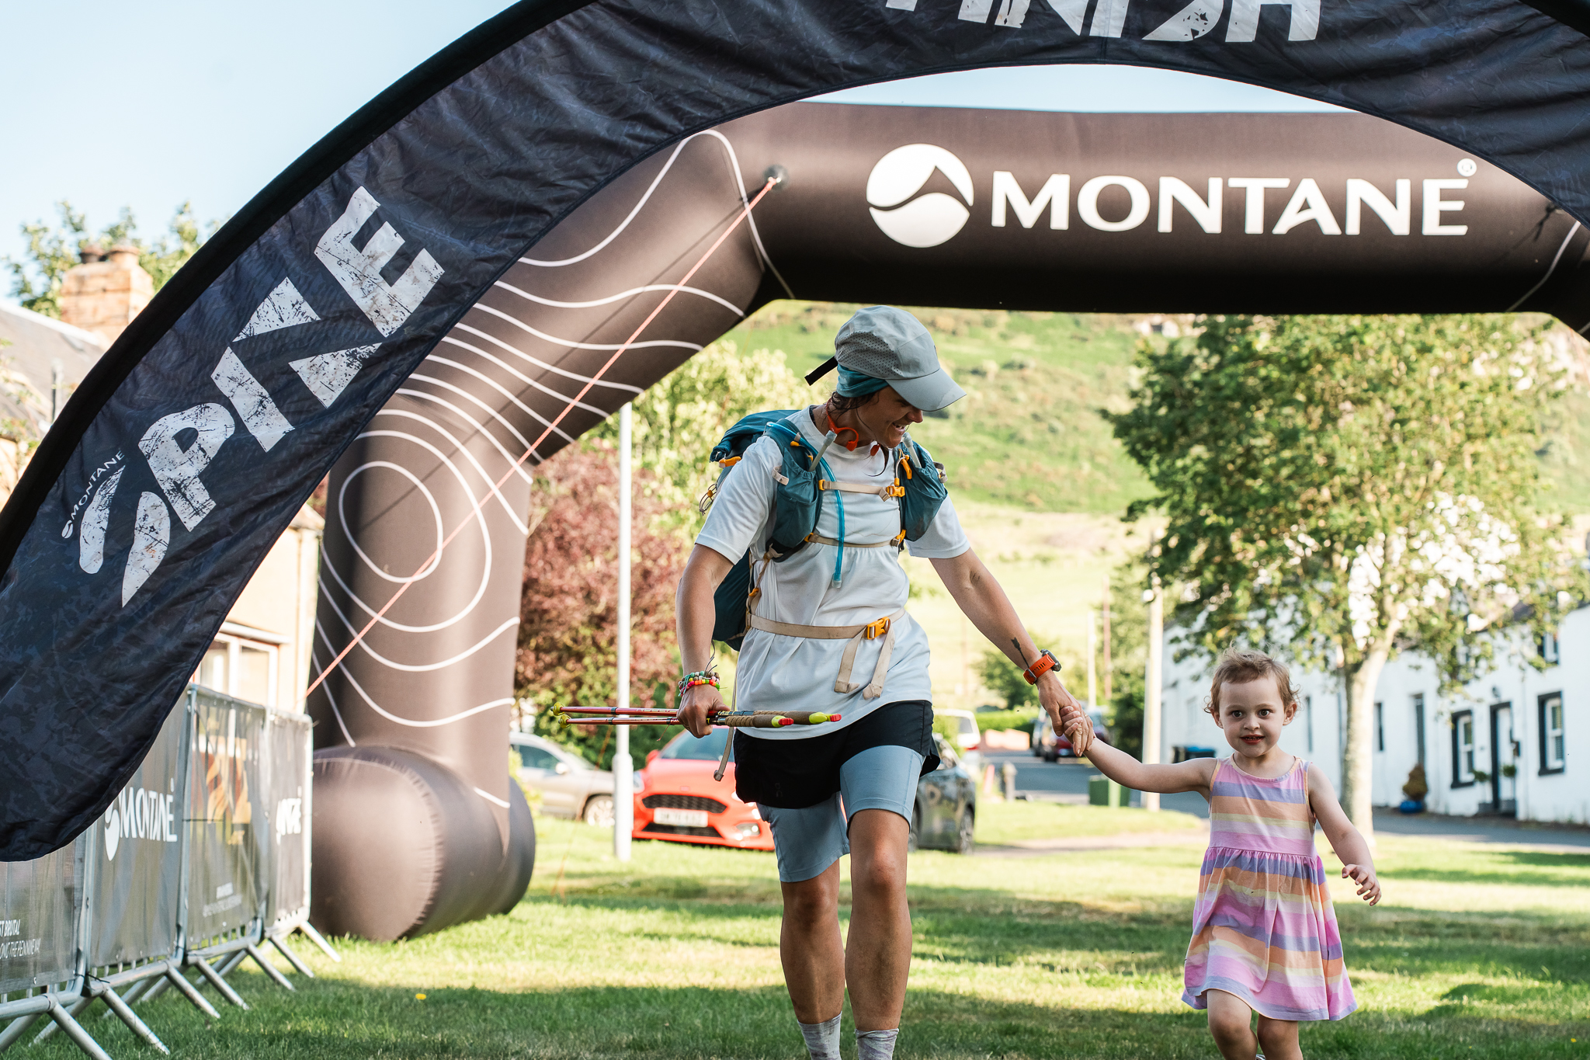
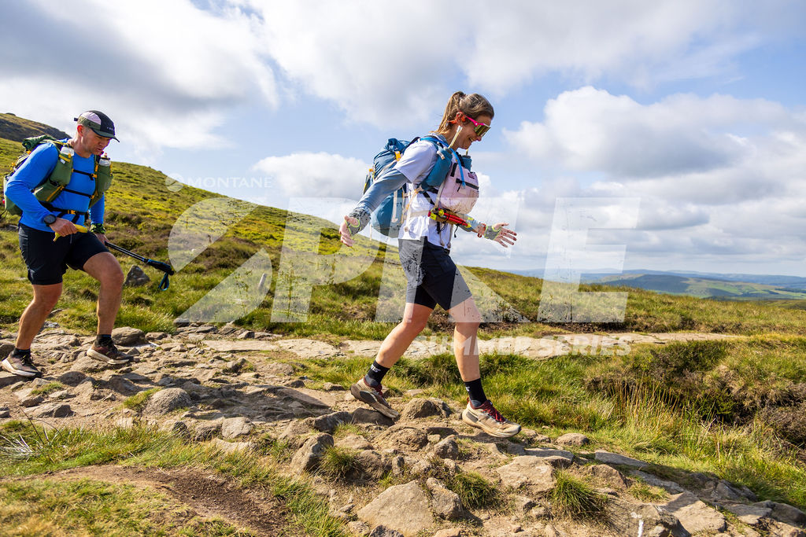
SUSTAINABLITY PROMISE
OPPORTUNITIES FOR GIRLS
Twyford St Mary’s is a small primary school with a big ambition: to give every child an equal opportunity to thrive through sport. However, like many small schools, limited funding and resources mean provision is stretched and participation is not equal. Although after-school sport runs daily, it is currently dominated by boys. This reflects a wider national issue.
Across the UK, girls face persistent barriers to taking part in sport, including lower confidence, fewer opportunities, and social pressures. Research shows that 62% of girls want to be more active but feel held back by factors such as confidence and fear of judgement.
Our goal is to raise £25,000 to fund a dedicated sports teacher who will deliver daily, girls-focused after-school sessions for a full academic year at Twyford St Mary’s.
In June 2026, the founder of Twist Health will be taking on The Montane Summer Spine Race to raise money for this project.
Our
Community
Health is something that affects all of us so, as a service provider in the healthcare space, it is important that where we can we raise awareness and support healthy living within our local community.
COMMUNITY
We want to be a positive name in our community – giving back to the communities we work with and within.

Slide 15
What we said we would do: | What we did: | What we are going to do:
Look to develop a community garden in the spot next to the office. | We were unsuccessful in being able to develop a community garden on the waste land. We have instead rented a local allotment plot. | We intend to grow fruit and veg and will make enquires to see if children from the local primary school are able to visit the site for learning purposes.
If we are unable to establish the community garden, we will proactively look at other ways to engage and support the local community using profits from Twist Health. | We funded the local Twyford 10k trail race which raised £4,500 for the local primary school. Two members of the team voluntarily organised the race which was fully supported by the local community. | We are going to voluntarily organise the race again next year. We intend to increase the numbers, the sponsorship and intend to donate to more local charities.
Introduce more girls’ sports in the local primary school. | We are currently in discussions with our clients, looking for funding to initially set up an extra curricular girls’ sports club for girls at the local primary school. This would involve paying for an experienced sports teacher and a venue. We have discussed this idea with the headmaster of the primary school who is very keen. We have created a Just Giving Page which will be circulated to the school and local community. | We intend to get funding/sponsorship from our client and local community to pay for a sport teacher and a venue. After this we are hoping the after-school sports club will fund itself. We are looking for a venue and will approach the local community centre and Twyford Prep School to see if they an accommodate us.
We will continue our work with MediCinema donating our time and resources to ensuring they are able to implement as many cinemas into hospitals, and impact as many patients as possible. Having regular catch up with their team to up skill and support them in the analysis of data collected. | Working with MediCinema ProBono to develop data from patient surveys that will demonstrate their effectiveness in supporting patients’ wellbeing. The data collected so far has already shown really strong results in this. We also explored numerous ProBono projects with charities to use our skillset for the common good. | We are going to speak to our lead on this and find out how we can continue to support them. Twist health donate 1 day month to support MediCinema.

Slide 16
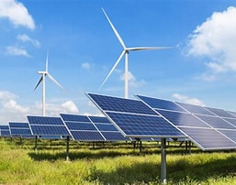

SUSTAINABLITY PROMISE
WORKPLACE
We have a central office in Twyford, near Winchester but our people are supported to work from the places that mean they get the most out of their day. Where you work should not be a barrier to advancement in your career.
Our
Workplace
WASTE
Ensuring the places that we work are doing their bit to impact the wider environment.
We are currently a zero waste to landfill workplace. Our paper is recycled, our old electronics are donated to charities for use and even our coffee grinds are given to the local allotments for use on the land.
WORKPLACE
We are committed to providing a sustainable workplace environment that does not negatively impact our environment whether that be virtual or office-based.
.
ENERGY CONSUMPTION
We endeavour to use as little energy as possible and the energy we do use is sourced from sustainable and renewable resources.

Slide 17
What we said we would do: | What we did: | What we are going to do:
Work towards zero printing across the business | We continued to print less than 10 sheets of paper printer per month including print for meetings. We do however need to formalize the reporting of this and will look to do this in 2025. | We will draw up a report of how much printing is done per month.
Ensure suppliers are also minimising paper waste. | We have a supplier policy that describes our expectations of printing and waste as well as energy use, as well as a remote working policy. | We will continue to ensure that our suppliers understand our zero waste expectation.
Review working from home practices to ensure staff are enabled to use energy responsibly when working from home. | We have implemented a working from home policy that details expectations to employees around responsible energy use, waste and low emissions commuting to meetings where practical. We rarely ask employees to travel to the central office. | We will continue to remind our employees of responsible energy use waste and low emissions.
Look to develop a community garden in the spot next to the office, transforming some waste ground into a community educational resource and sanctuary for the community and local children to learn about plants, their medicinal purposes and the importance of nurturing nature for a better world. | Sadly this was unsuccessful but we have been able to rent an allotment to grow fruit and veg. The founder of Twist Health has also bought chickens and regularly brings eggs to members of the team. | We are going to continue the upkeep of the allotment and distribute any produce grown with members of staff and the local community where possible.
Ensure our electricity is renewable. | Our electricity supply to the office is 100% renewables based. | Continue to ensure we are conserving energy and ensure we are wearing extras layers in colder months. We will not use heating and lighting unnecessarily.

Slide 18
What we said we would do: | What we did: | What we are going to do:
Be mindful and use minimal electricity/ minimal water waste. | When setting up the office we have low impact bulbs and proximity lighting to minimise usage. We have reduced the size of the boiler in the office to minimise water use and hot water use. We have used programmable heaters that automatically emit heat at certain times and restrict heat when the building is unoccupied. | We will continue to use these bulbs and only put the lights on if necessary, preferably using natural light.
Reduce printing to save on paper and costs. | We have no printer onsite to reduce the ability to print and encourage online printing. | We intend to continue on this path and encourage all employees and providers to be paper-free.

Slide 19
What we said we would do: | What we did: | What we are going to do:
Proactively seek out opportunities to work with Bcorps within our industry and partner together on projects where our collective input will have a positive impact. | We have a signed agreement with a Bcorp in our area where we are conducting work together. We attempted to engage another Bcorp in a Bcorp community project that would bring a multitude of Bcorps together for a common purpose, however we are yet to hear back from this company (company name not disclosed for confidentiality) We have joined the BHive Community and currently monitor any events of mutual interest. | We were hoping to use Octopus electricity but, with the current Iran war and fuel crisis, there is a lot of uncertainty. At this time, it makes more financial sense to stay with our current provider. However, we are keen to use/work with other Bcorps businesses.
Develop a customer satisfaction survey that incorporates elements of sustainability and environmental impact to assess progress. | We have created a customer satisfaction survey and are issuing to clients to assess how they felt we prioritised sustainability in their projects. | We will publish the results.
Attempt to identify industry benchmarks to measure against and communicate our progress to our customers. | Underway
Reduce our carbon footprint and emissions. | Encouraged all our clients to use online meetings to avoid unnecessary travel and emissions, therefore reducing our carbon footprint. | We will continue to encourage our employees and clients not to travel, and use online meetings wherever possible.

